Slide 1
Determinants

Slide 2
Determinant of a 2 × 2 Matrix

Slide 3
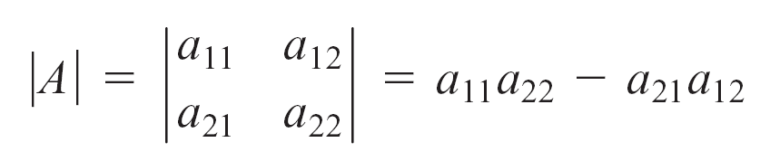
Determinant of a 2 × 2 Matrix
Associated with each square matrix A is a number called the determinant of A.
We will denote the determinant of the matrix A by
det(A) or by | A |.
Definition of the Determinant of a 2 × 2 Matrix
The determinant of the matrix A = [a_{ij}] of order 2 is

Slide 4
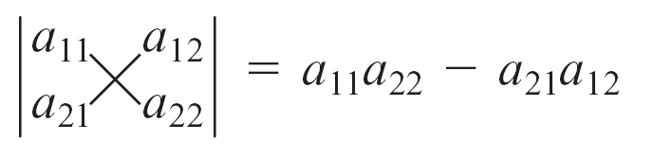
Determinant of a 2 × 2 Matrix
An easy way to remember the formula for the determinant
of a 2 × 2 matrix is to recognize that the determinant is the
difference between the products of the diagonal elements.
That is,

Slide 5
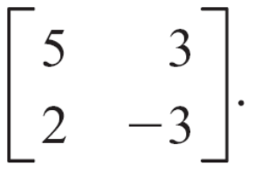
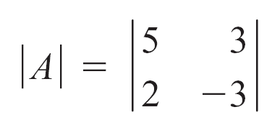
Example 1 – Find the Value of a Determinant
Find the value of the determinant of the matrix A =
Solution:
= 5(–3) – 2(3)
= –15 – 6
= –21

Slide 6
Minors and Cofactors

Slide 7
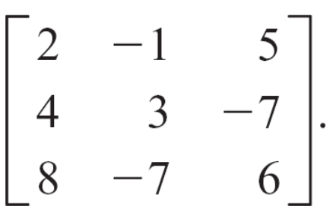
Minors and Cofactors
To define the determinant of a matrix of order greater than 2, we first need two other definitions.
Definition of the Minor of a Matrix
The minor M_{ij} of the element a_{ij} of a square matrix A of order n ≥ 3 is the determinant of the matrix of order n – 1
obtained by deleting the ith row and the jth column of A.
Consider the matrix A =

Slide 8
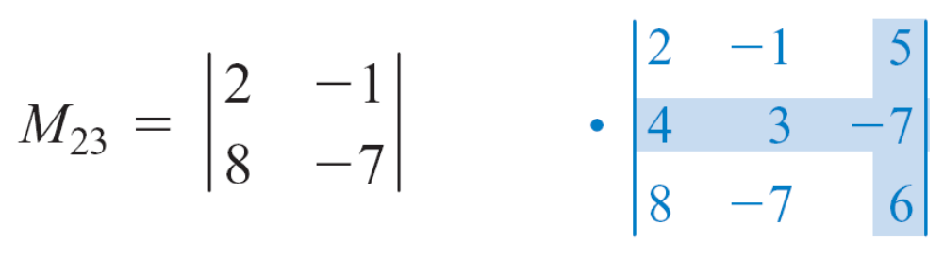
Minors and Cofactors
The minor M₂₃ is the determinant of the matrix A formed by deleting row 2 and column 3 from A.
= 2(–7) – 8(–1) = –14 + 8 = – 6

Slide 9
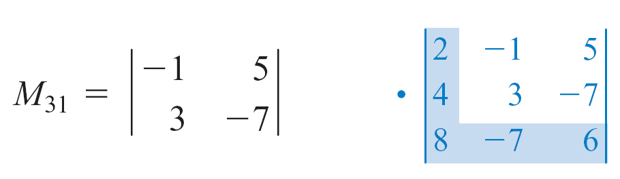
Minors and Cofactors
The minor M₃₁ is the determinant of the matrix A formed by deleting row 3 and column 1 from A.
= (–1)(–7) – 3(5) = 7 – 15 = – 8

Slide 10

Minors and Cofactors
The second definition we need is that of the cofactor of a matrix.
Definition of a Cofactor of a Matrix
The cofactor C_{ij} of the element a_{ij} of a square matrix A is
given by C_{ij} = (–1)^{i + j}M_{ij}, where M_{ij} is the minor of a_{ij}.
When i + j is an even integer, (–1)^{i + j} = 1.
When i + j is an odd integer, (–1)^{i + j} = –1.
Thus
M_{ij}, i + j is an even integer
–M_{ij}, i + j is an odd integer
C_{ij} =

Slide 11
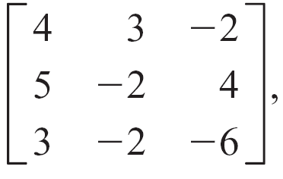
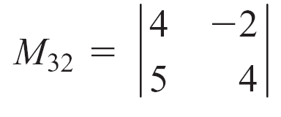
Example 2 – Find a Minor and a Cofactor of a Matrix
Given A = find M₃₂ and C₁₂.
Solution:
= 4(4) – 5(–2)
= 16 – (–10)
= 16 + 10
= 26

Slide 12
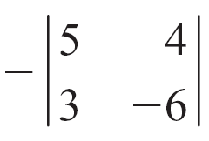
Example 2 – Solution
cont’d
C₁₂ = (–1)¹ ⁺ ²M₁₂
= –M₁₂
=
= –(–30 – 12)
= 42

Slide 13
Evaluating a Determinant Using Expanding by Cofactors

Slide 14
Evaluating a Determinant Using Expanding by Cofactors
Cofactors are used to evaluate the determinant of a matrix
of order 3 or greater.
The technique used to evaluate a determinant by using cofactors is called expanding by cofactors.
Evaluating Determinants by Expanding by Cofactors
Given the square matrix A of order 3 or greater, the value of the determinant of A is the sum of the products of the elements of any row or column and their cofactors.

Slide 15
Evaluating a Determinant Using Expanding by Cofactors
For the rth row of A, the value of the determinant of A is
| A | = a_{r1}C_{r1} + a_{r2}C_{r2} + a_{r3}C_{r3} + … + a_{rn}C_{rn}
For the cth column of A, the determinant of A is
| A | = a_{1c}C_{1c} + a_{2c}C_{2c} + a_{3c}C_{3c} + … + a_{nc}C_{nc}
This theorem states that the value of a determinant can be found by expanding by cofactors of any row or column.
The value of the determinant is the same in each case.

Slide 16
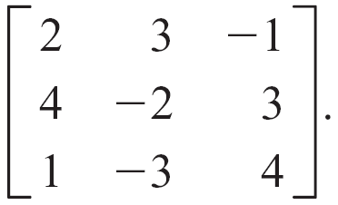
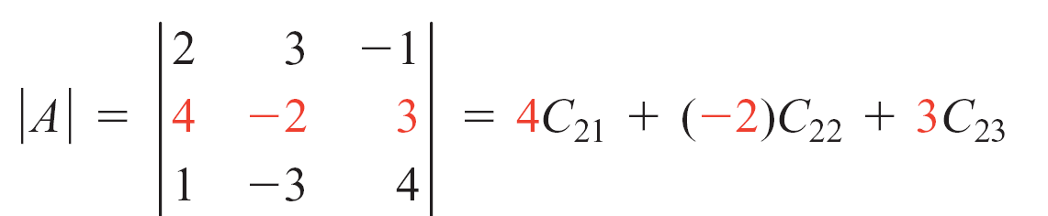
Evaluating a Determinant Using Expanding by Cofactors
To illustrate the method, consider the matrix A =
Expanding the determinant of A by some row—say, row 2—gives

Slide 17
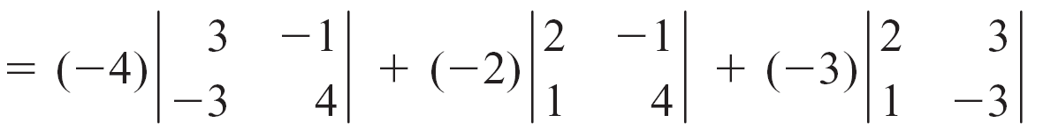
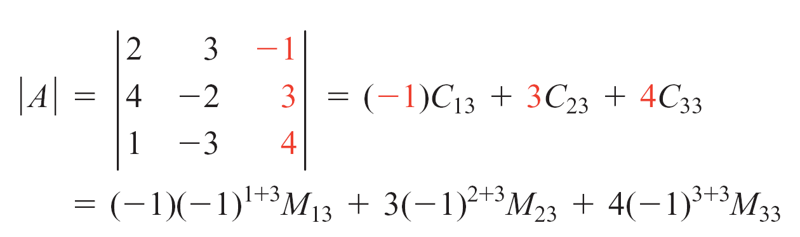
Evaluating a Determinant Using Expanding by Cofactors
Expanding the determinant of A by some column—say, column 3—gives

Slide 18
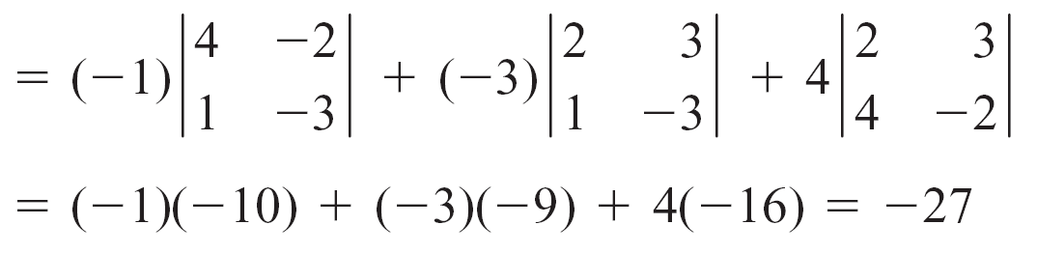
Evaluating a Determinant Using Expanding by Cofactors
The value of the determinant of A is the same whether we expanded by cofactors of the elements of a row or by cofactors of the elements of a column.
When evaluating a determinant, choose the most convenient row or column, which usually is the row or column containing the most zeros.

Slide 19
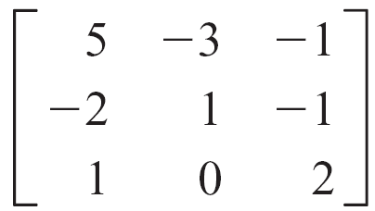
Example 3 – Evaluate a Determinant by Expanding by Cofactors
Evaluate the determinant of A = by expanding by cofactors.
Solution:
Because a₃₂ = 0, expand using row 3 or column 2. Row 3 will be used here.
| A | = 1C₃₁ + 0C₃₂ + 2C₃₃
= 1(–1)³ ⁺ ¹M₃₁ + 0(–1)³ ⁺ ²M₃₂ + 2(–1)³ ⁺ ³M₃₃

Slide 20
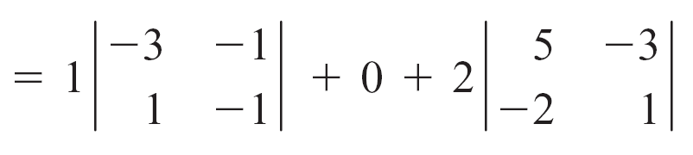
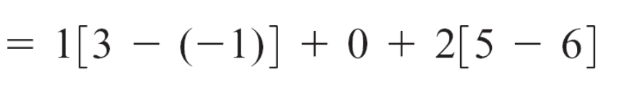


Example 3 – Solution
cont’d

Slide 21
Evaluating a Determinant Using Elementary Row Operations

Slide 22
Evaluating a Determinant Using Elementary Row Operations
Effects of Elementary Row Operations on the Value of a Determinant of a Matrix
If A is a square matrix of order n, then the following elementary row operations produce the indicated changes in the determinant of A.
1. Interchanging any two rows of A changes the sign of | A |.
2. Multiplying a row of A by a constant k multiplies the determinant of A by k.
3. Adding a multiple of a row of A to another row does not change the value of the determinant of A.

Slide 23
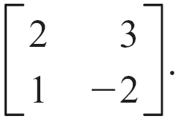
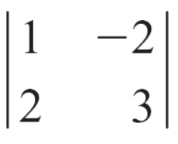
Evaluating a Determinant Using Elementary Row Operations
To illustrate these properties, consider the matrix A =
The determinant of A is | A | = 2(–2) – 1(3) = –7.
Now consider each of the elementary row operations.
Interchange the rows of A and evaluate the determinant.
= 1(3) – 2(–2) = 3 + 4 = 7 = –| A |

Slide 24
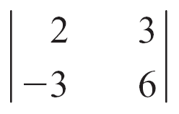
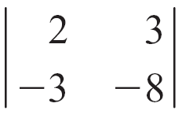
Evaluating a Determinant Using Elementary Row Operations
Multiply row 2 of A by –3 and evaluate the determinant.
= 2(6) – (–3)3 = 12 + 9 = 21 = –3| A |
Multiply row 1 of A by –2 and add it to row 2. Then evaluate the determinant.
= 2(–8) – (–3)(3) = –16 + 9 = –7 = | A |.

Slide 25
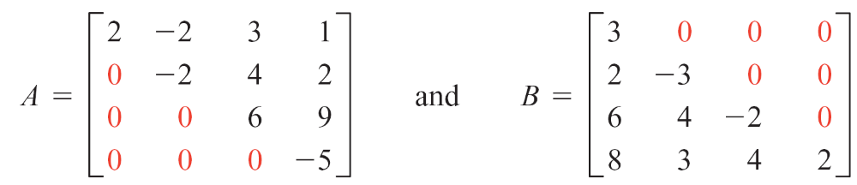
Evaluating a Determinant Using Elementary Row Operations
These elementary row operations are often used to rewrite a matrix in triangular form.
A matrix is in triangular form if all elements below or above the main diagonal are zero.
The matrices
are in triangular form.

Slide 26
Evaluating a Determinant Using Elementary Row Operations
Determinant of a Matrix in Triangular Form
Let A be a square matrix of order n in triangular form. The determinant of A is the product of the elements on the main diagonal.
| A | = a₁₁a₂₂a₃₃ … a_{nn}
Example
For the matrices A and B given above,
| A | = 2(–2)(6)(–5) = 120
| B | = 3(–3)(–2)(2) = 36

Slide 27
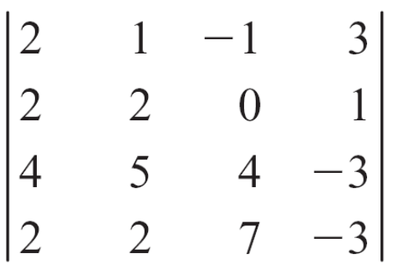
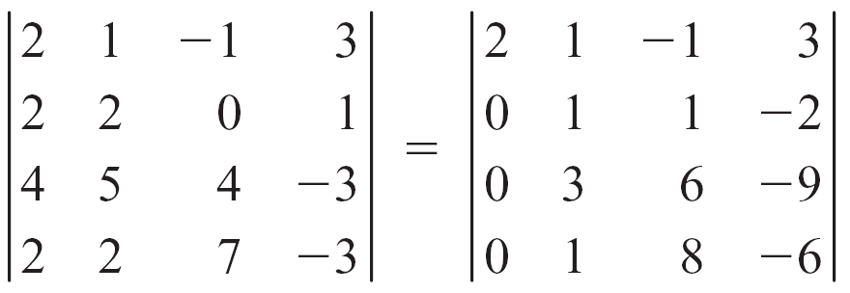
Example 4 – Evaluate a Determinant by Using Elementary Row Operations
Evaluate the determinant by rewriting it in triangular form.
Solution:
Rewrite the determinant in triangular form by using elementary row operations.
–1R₁ + R₂
–2R₁ + R₃
–1R₁ + R₄

Slide 28
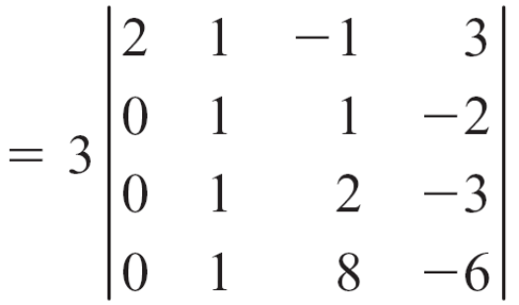
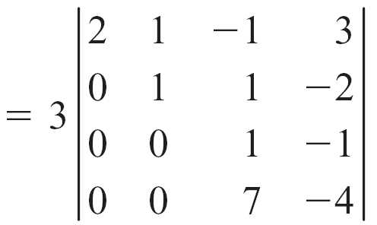
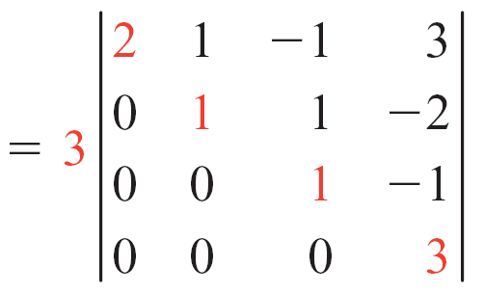


Example 4 – Solution
cont’d
Factor 3 from row 3.
–1R₂ + R₃
–1R₂ + R₄
–7R₃ + R₄

Slide 29
Evaluating a Determinant Using Elementary Row Operations
In some cases, it is possible to recognize when the determinant of a matrix is zero.
Conditions for a Zero Determinant
If A is a square matrix, then | A | = 0 when any one of the following is true.
1. A row (column) consists entirely of zeros.
2. Two rows (columns) are identical.
3. One row (column) is a constant multiple of a second row (column).

Slide 30
Evaluating a Determinant Using Elementary Row Operations
Product Property of Determinants
If A and B are square matrices of order n, then
| AB | = | A || B |

Slide 31
Condition for a Square Matrix to Have a Multiplicative Inverse

Slide 32
Condition for a Square Matrix to Have a Multiplicative Inverse
Recall that a singular matrix is one that does not have a multiplicative inverse.
The product property of determinants can be used to determine whether a matrix has an inverse.
Consider a matrix A with an inverse A^{–1}.
Then, by the product property of determinants
| A  A^{–1} | = | A || A^{–1} |

Slide 33
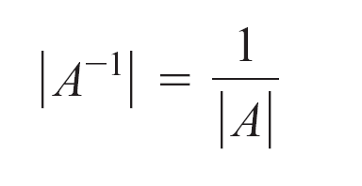
Condition for a Square Matrix to Have a Multiplicative Inverse
But A  A^{–1} = I, the identity matrix, and | I | = 1.
Therefore,
1 = | A || A^{–1} |
From the last equation, | A | ≠ 0. And, in particular,

Slide 34
Condition for a Square Matrix to Have a Multiplicative Inverse
These results are summarized in the following theorem.
Existence of the Inverse of a Square Matrix
If A is a square matrix of order n, then A has a multiplicative inverse if and only if | A | ≠ 0. Furthermore,

